Slide 1
Nakuja internship
WEEK 12 PROGRESS REPORT

Slide 2
TASKS COMPLETED THIS WEEK
[#71] Casing Fabrication
[#56] Fuel Casting
[#68] Remote Ignition Testing

Slide 3
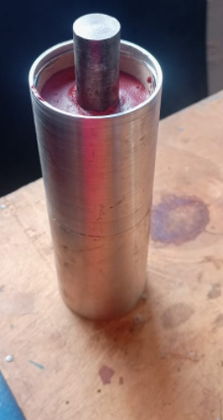
#71 Casing fabrication
We fabricated a smaller casing to be used for the test launch scheduled for a later date

Slide 4
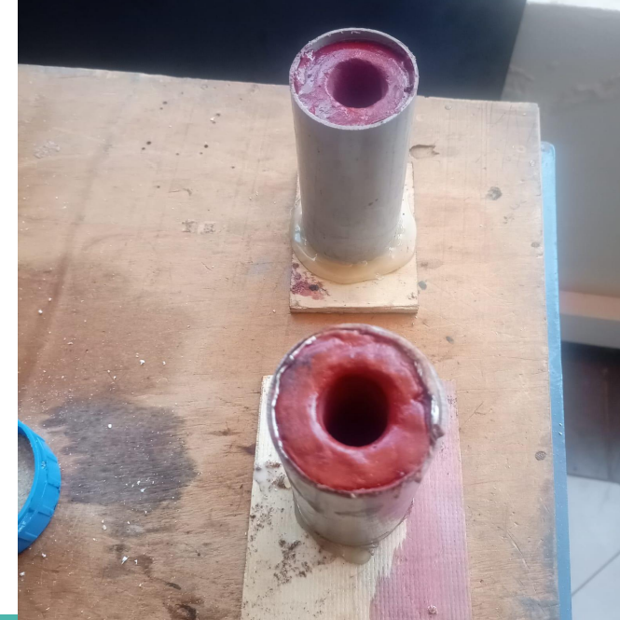
#56 Fuel Casting
We prepared two grains of fuel. The mixing ratio was 67:33 potassium nitrate to sorbitol, 4g of iron oxide. The grains will be used in a static test to be conducted today.

Slide 5
Tasks this week
[#150] Test Flight
[#] Snap Ring Purchase

Slide 6
timeline
Month | Intern week | Tasks
Jan
 | Week 1 | Designs [Fuel, Casing, Nozzle, Bulkhead, Casting tools, Test stand]
 | Week 2 | Fabrication of items
 | Week 3 | Fuel Fabrication and test stand revamp
Feb | Week 4 | Fabrication of items & Fuel casting
 | Week 5 | Iterative Fuel tests
 | Week 6 | Launch Pad design and iterative fuel tests
 | Week 7 | Iterative fuel testing and improvement

